Slide 1
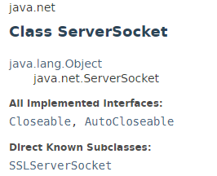
Java Socket Programming Example
This class implements server sockets. A server socket waits for requests to come in over the network. It performs some operation based on that request, and then possibly returns a result to the requester.

Slide 2
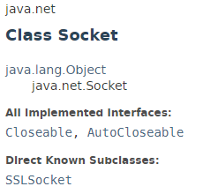
Java Socket Programming Example
This class implements client sockets (also called just "sockets"). A socket is an endpoint for communication between two machines.

Slide 3
Java Socket Programming Example
https://docs.oracle.com/javase/8/docs/api/index.html?java/net/ServerSocket.html
https://docs.oracle.com/javase/8/docs/api/index.html?java/net/Socket.html

